Slide 1
Semester 2 Project Plan
Florida Tech History Tours

Slide 2
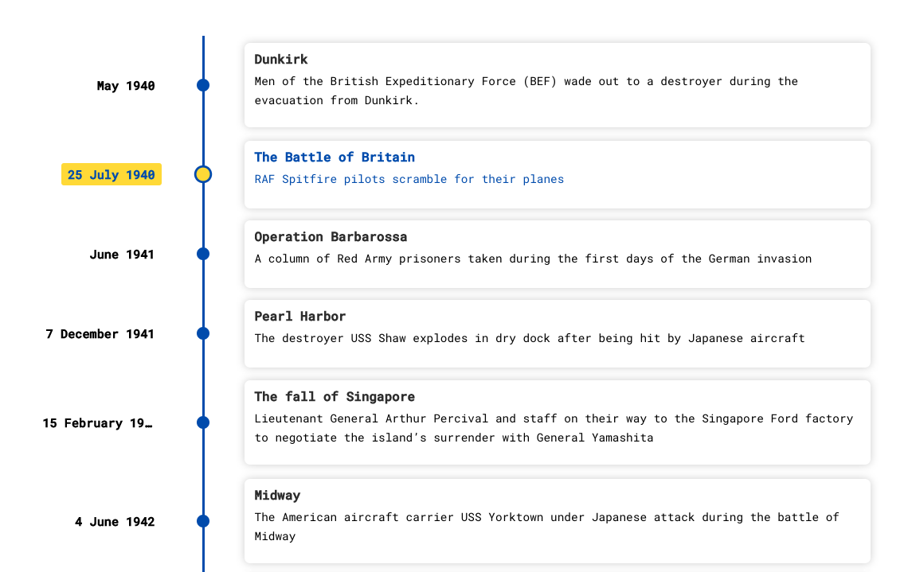


Algorithms and Tools/Integrations

Slide 3
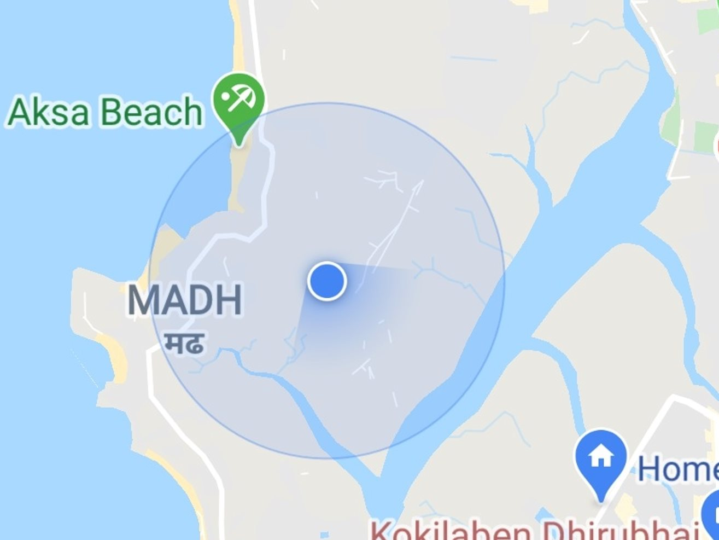
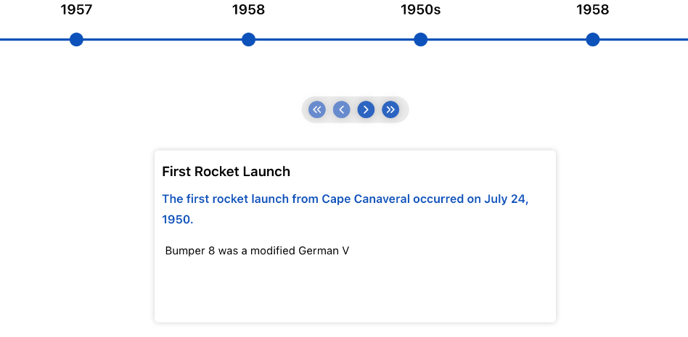
Technical Challenges
GPS Inaccuracies
Timeline Data Streaming

Slide 4
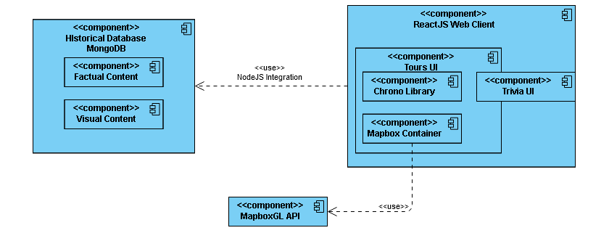
Design of the System

Slide 5
System Evaluation Criteria
Accuracy: Facts presented to users about Florida Tech and its buildings are correct and up to date. The map displays user location when geolocation is active within a 100ft radius of their actual position.
Speed: The speed will come from three key metrics of the web application: initial load time, timeline update time, and location service update time.
Reliability: The reliability of the application should correctly get the user down the correct path eight out of ten times; while the user should still be able to reach the end goal with a new path 9.9 out of 10 times.
User Survey: Users can rate different aspects on a scale of 1 to 10; such as how engaging the trivia is, how easy the app is to navigate and understand, and which point of interests they find the best and most informative.

Slide 6
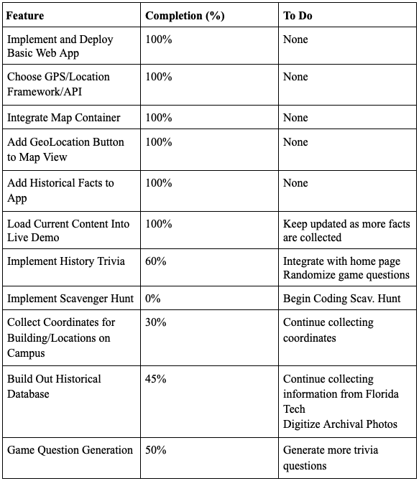
Progress Summary

Slide 7
Next Three Milestones
Milestone 4 Tasks
Implement initial tour paths for guided navigation
Design and Integrate Layouts for the Points of Interest across campus
Begin Implementation of the additional game(s), e.g. scavenger hunt, name game, etc.
Create Geofences with latitude and longitude values for campus buildings
Milestone 5 Tasks
Create full campus tours for the various routes
Design and implement settings menu for application settings and social media sharing
Begin evaluation of the system for final analysis
Create Poster for Senior Design Showcase
Milestone 6 Tasks
Clean up the UI and add in debug options for location and other resources
Conduct full system test for evaluation and analysis of success
Create user/developer manual
Create demo video

Slide 8
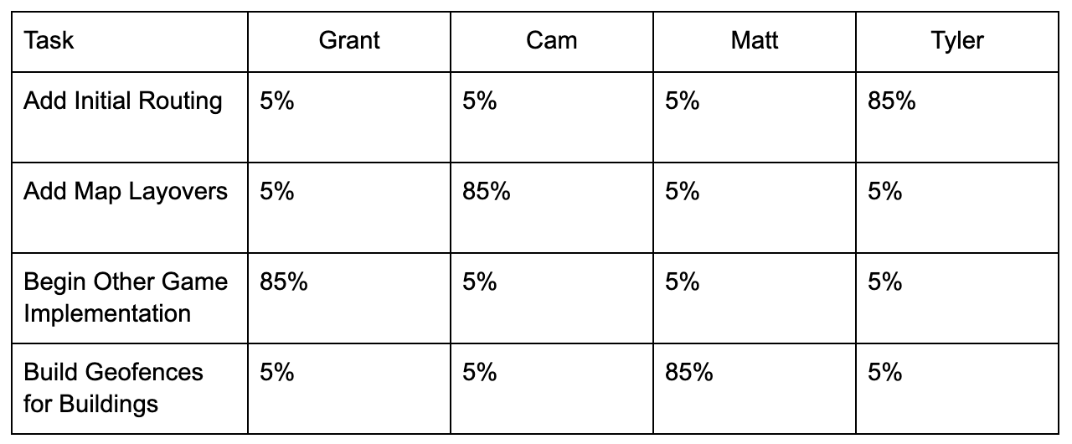
Next Milestone Matrix

Slide 9
Questions?

